Slide 1


Slide 2

_{WHAT IT IS}
_{WHY USE IT}
_{THE COMMUNITY}
_{USING OPENSTACK}
_{FAQS}
Before we get to OpenStack…
A Word On “The Cloud”
THERE’S A GLOBAL SHIFT TOWARD CLOUD. THE BENEFITS: AGILITY, SCALABILITY, DECREASED HARDWARE COSTS.
Public cloud: shared resource, “pay-as-you-go” models are common
Hybrid cloud: a mix of private cloud and public cloud orchestrated together to meet company needs
Private Cloud: dedicated to a single user
3 CLOUD MODELS
Notes:
To understand why all these companies are using OpenStack, we have to understand the recent advances and developments in operations and the move to the cloud. The OpenStack story is part of the larger global shift towards cloud systems. Companies of all sizes are realizing that the speed, sheer volume and desired-flexibility of today’s environment might not mesh with their legacy system or might leave some of their needs unmet. Cloud solutions can lower hardware costs, increase agility and allow companies to spin up or down resources as needed.

Slide 3
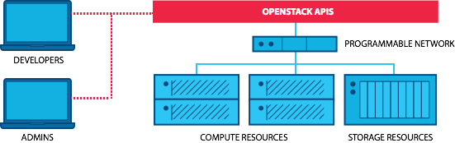
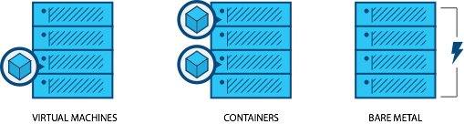
_{WHAT IT IS}
_{WHY USE IT}
_{THE COMMUNITY}
_{USING OPENSTACK}
_{FAQS}
What is OpenStack
Programmable infrastructure that lays a common set of APIs on top of compute, networking and storage
One platform for virtual machines, containers and bare metal
Notes:
OpenStack is open source software for building clouds. It is programmable infrastructure that allows users to have one platform for virtual machines, containers and bare metal. Hundreds of companies and tens of thousands of individuals from around the world have come together to create and support OpenStack because they believe in the importance of a standardized, ubiquitous cloud platform. OpenStack has multiple projects under its name. The projects cover foundational elements like compute, networking and storage, but also span from telemetry to orchestration to container APIs. You likely know an OpenStack user or vendor without even realizing it; half of the Fortune 100 use OpenStack.

Slide 4
_{WHAT IT IS}
_{WHY USE IT}
_{THE COMMUNITY}
_{USING OPENSTACK}
_{FAQS}
OpenStack is open source
HERE’S WHY THAT MATTERS
OPENSTACK PRINCIPLES
Choice & control: ability to choose between and switch vendors
Ability to contribute or directly influence the roadmap
OPEN SOURCE
1
OPEN DESIGN
2
OPEN DEVELOPMENT
3
Widely adopted open source APIs are the new standards
Part of a vibrant community to share knowledge and help each other
OPEN COMMUNITY
4
Notes:
OpenStack is one of the world’s largest open source projects. That means that it was created by people who contributed their time and talent to the project, and that no one “owns” OpenStack. OpenStack is able to constantly evolve and constantly improve because of its open source nature, and when needs arise or situations change, the community can quickly respond with innovative solutions. OpenStack is licensed under the Apache 2.0 license, which means that it is free to use, free to distribute and that others can modify OpenStack for their own needs. This creates a rich suite of options that all operate on the same underlying infrastructure. For users, this means you can switch between vendors or combine services without fear of being locked into a single, proprietary solution.

Slide 5
_{WHAT IT IS}
_{WHY USE IT}
_{THE COMMUNITY}
_{USING OPENSTACK}
_{FAQS}
Primary business drivers
#1 cost
(⅔ of users said cost was their #1 business driver)
#2 operational efficiency
#3 accelerate innovation
Source: User Survey, April 2016, 1183 responses
Notes:
Narration can include the text from this chart to explain a use case associated with each workload heading.

Slide 6







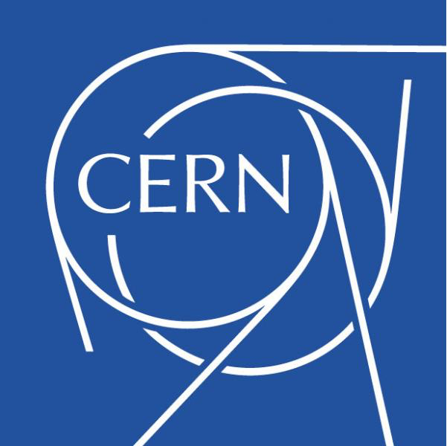










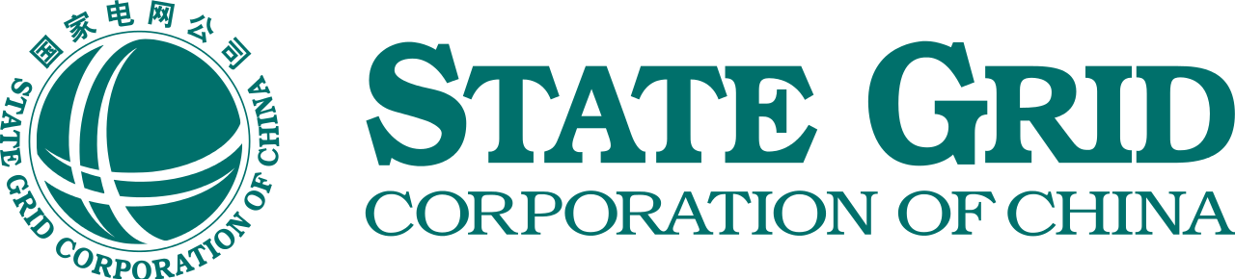

_{WHAT IT IS}
_{WHY USE IT}
_{THE COMMUNITY}
_{USING OPENSTACK}
_{FAQS}
Which industries choose OpenStack?
_{RETAIL/E-COMMERCE}
_{FINANCIAL}
_{TELECOM}
_{ACADEMIC/RESEARCH}
_{ENERGY}
_{MANUFACTURING}
_{ENTERTAINMENT}
See more at openstack.org/user-stories

Slide 7
_{WHAT IT IS}
_{WHY USE IT}
_{THE COMMUNITY}
_{USING OPENSTACK}
_{FAQS}
What runs on OpenStack?
_{TELECOM/NFV}
_{HPC}
_{ENTERPRISE APPS}
_{BIG DATA}
86% of telecoms say OpenStack is important to their business; many are using OpenStack to virtualize their networks and implement edge computing to achieve agility significant cost savings.
CERN runs one of the largest OpenStack clouds to process data from the Large Hadron Collider, giving physicists the resources they need to unleash the secrets of the universe.
Comcast powers customer-facing and internal applications and services for both production and development environments with OpenStack.
Banco Santander runs 1,000 compute nodes of OpenStack in data centers across the world, and uses Cloudera on OpenStack to power fraud detection.
_{MULTI-CLOUD}
_{E-COMMERCE}
_{DEVELOPER PRODUCTIVITY}
_{WEB SERVICES}
DigitalFilm Tree uses interoperable OpenStack private and public clouds to process thousands of hours of raw footage into a one-hour TV show.
Walmart moved their global e-commerce platform to OpenStack, powering desktop, mobile, tablet and kiosk users.
Adobe Digital Marketing uses OpenStack to convert their existing virtualization environment into self-service IT.
Workday moved their on-demand software services from static, virtualized environments to a fully elastic and scalable platform based on OpenStack.
Notes:
Narration can include the text from this chart to explain a use case associated with each workload heading.

Slide 8
_{WHAT IT IS}
_{WHY USE IT}
_{THE COMMUNITY}
_{USING OPENSTACK}
_{FAQS}
History of OpenStack
₂₀₁₀
₂₀₁₄
_{2016 - April}
₂₀₁₇
NASA + Rackspace develop the basis of OpenStack
OpenStack Marketplace opens to showcase maturing ecosystem; “Juno” release seen as enterprise grade
Half the Fortune 100 run OpenStack; Certified OpenStack Administrator program launched
OpenStack emerges as one platform for containers,
VMs and bare metal
₂₀₁₂
₂₀₁₅
₂₀₁₆
OpenStack Foundation established
OpenStack Powered interop certification launched
China booms; 86% of telecoms say OpenStack important to their business
Notes:
In 2010, Rackspace was rewriting code for their cloud infrastructure and was considering open sourcing some of it. At the same time, NASA was also working on code for cloud infrastructure. They combined efforts and it became the base for OpenStack. The first OpenStack Summit was held in Austin, Texas in July 2010 with 75 participants. To give you a sense of scale, the Summit returned to Austin this year (2016, six years later), with well over 7,500 participants.
In 2012, the OpenStack Foundation was formed, which we’ll talk more about momentarily. The Foundation oversees the projects and stewards the community.
In 2014, the OpenStack Marketplace was established, which is a portal at Openstack.org/marketplace that helps potential users navigate what was, and continues to be, a rapidly growing ecosystem of vendors who offer everything from trainings on OpenStack to “pre-packaged” distributions of OpenStack projects. The Juno release was also launched, which was widely regarded as an enterprise-grade release.
In 2015, the OpenStack Powered interoperability certification launched. The OpenStack Powered badge is for products that run fully functional instances of OpenStack and have been tested to standards agreed upon by the ecosystem of vendors and users.
2016 was a booming year for OpenStack, as adoption by Chinese companies skyrocketed, and a Heavy Reading survey announced that 86% of telecoms said OpenStack is important to their business. By this time, half of the Fortune 100 was also running OpenStack, and the Certified OpenStack Administrator program launched, which is a professional certification that tests fundamental OpenStack skills.
Heading into 2017, OpenStack has continued to grow in its programmable infrastructure offering, giving users one platform for containers, vms, and bare metal.

Slide 9
_{WHAT IT IS}
_{WHY USE IT}
_{THE COMMUNITY}
_{USING OPENSTACK}
_{FAQS}
About the OpenStack Foundation
Mission To produce the ubiquitous Open Source Cloud Computing platform that will meet the needs of public and private clouds regardless of size, by being simple to implement and massively scalable.
Structure Board of Directors
Technical Committee
User Committee
Staff
Functions Maintain infrastructure for development & communication Coordinate software releases
Trademark and legal management
Host summits & development meetings
Promote the use of OpenStack
Notes:
In 2012 the OpenStack Foundation was created, which is an independent, nonprofit organization that governs the OpenStack project. The OpenStack Foundation was launched as an independent body providing shared resources to protect, empower, and promote OpenStack software and the community around it. The Foundation is made up of a Board of Directors, which has 24 members; a Technical Committee that oversees the technical director and cross-project issues, which has 13 members elected by the people who actively contribute to OpenStack; and full time staff members who help support the community.

Slide 10




















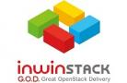



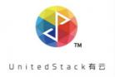



_{WHAT IT IS}
_{WHY USE IT}
_{THE COMMUNITY}
_{USING OPENSTACK}
_{FAQS}
OpenStack Foundation Sponsors
_{PLATINUM MEMBERS}
_{GOLD MEMBERS}

Slide 11



_{WHAT IT IS}
_{WHY USE IT}
_{THE COMMUNITY}
_{USING OPENSTACK}
_{FAQS}
The OpenStack Community
70,000+
185
650+
MEMBERS
COUNTRIES
ORGANIZATIONS
Notes:
OpenStack is a product of its active community, which continues to grow each year. There are more than 70,000 members of the community, from 185 countries and 650 organizations. There are 665 contributions to OpenStack monthly, which makes for more than 5.2million contributions in OpenStack’s lifetime. OpenStack was founded on the principles of openness and inclusion, and you can see this in the community-driven working groups and user groups around the world. Working groups include focus areas like diversity and women working on OpenStack. User groups are geographically-defined groups that bring those working on OpenStack together.

Slide 12


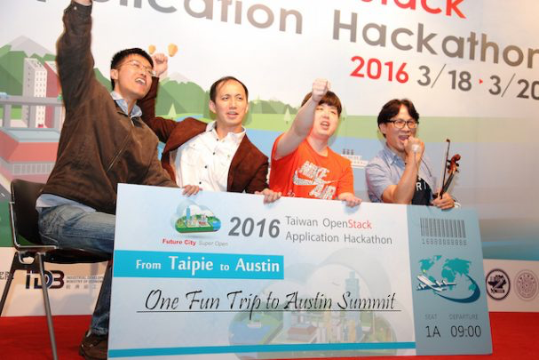
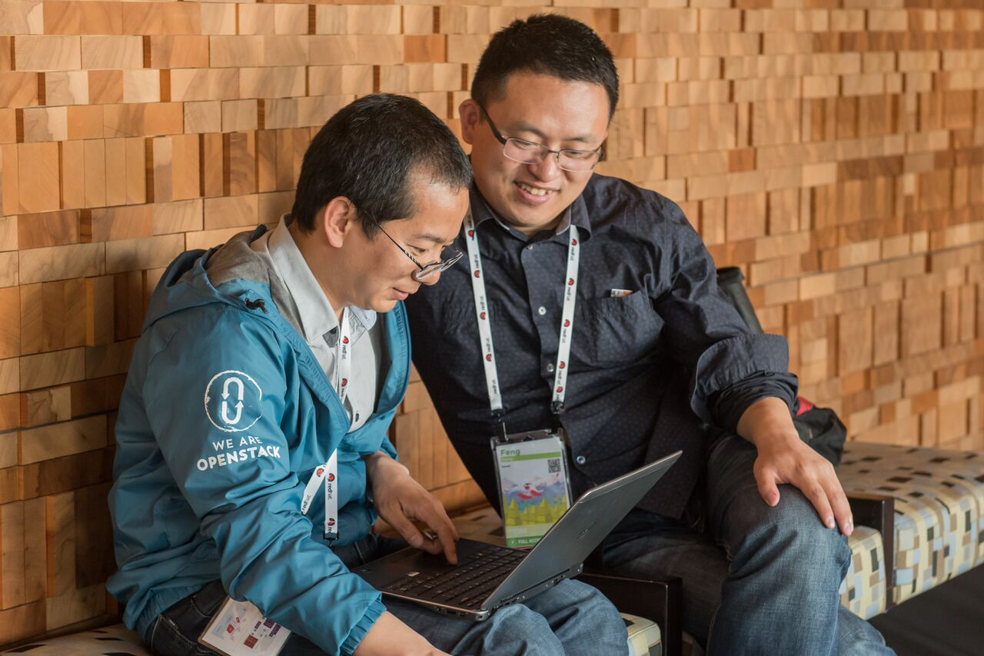
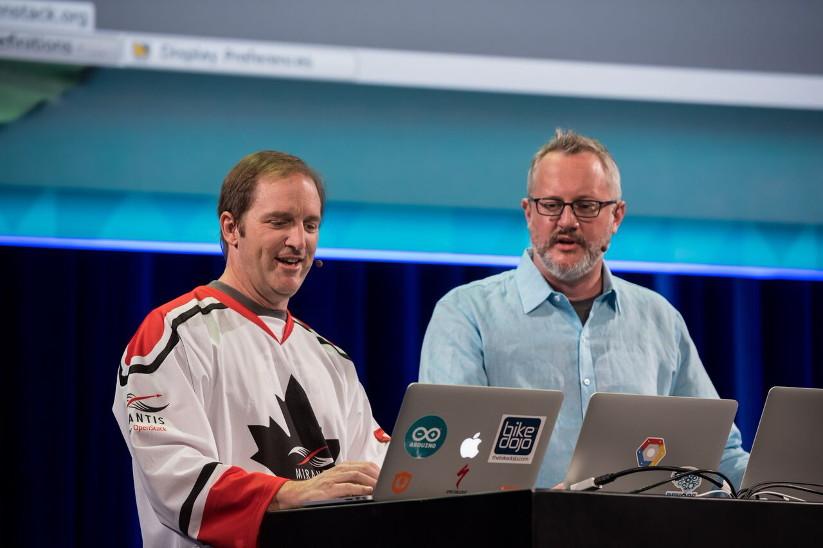
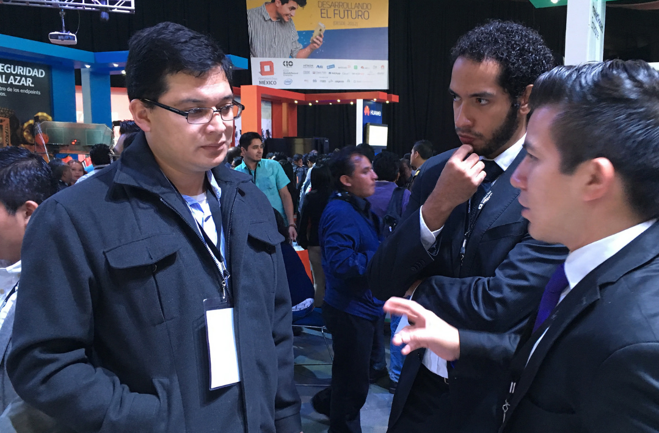
_{WHAT IT IS}
_{WHY USE IT}
_{THE COMMUNITY}
_{USING OPENSTACK}
_{FAQS}
How does the community collaborate?
_{GLOBAL OPENSTACK SUMMITS}
_{VOTING ON REPRESENTATIVES}
_{HACKATHONS}
_{TOPICAL MAILING LISTS}
CONTRIBUTING CODE, DEVELOPER PLANNING SESSIONS
REGIONAL OPENSTACK DAYS & LOCAL MEETUPS
Notes:
You can find the OpenStack community at the twice-annual global Summits; at local OpenStack Days, Hackathons and Meetups; participating on a wide variety of mailing lists; contributing code and participating in the design process; and voting on community representatives. You can learn more and sign up yourself at
openstack.org/join.

Slide 13
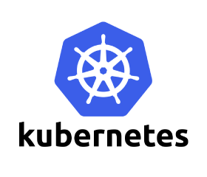

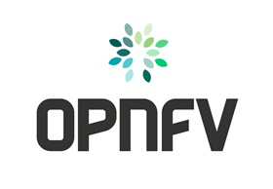

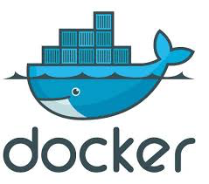

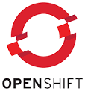

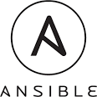
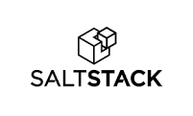

_{WHAT IT IS}
_{WHY USE IT}
_{THE COMMUNITY}
_{USING OPENSTACK}
_{FAQS}
Cross-community collaboration
OpenStack integrates with a number of other technologies, including many popular open source projects, enabling users to combine them with OpenStack.
Containers
PaaS
NFV
Provisioning
Notes:
In the early days of the Internet, it was the LAMP (Linux, Apache, MySQL, PHP) stack that enabled the rapid growth of the Web. OpenStack partners with many organizations to develop the LAMP stack of the cloud. OpenStack is just one piece of the story; users may also be running Mesos, Kubernetes, OpenContrail or Docker and much more. OpenStack works with other organizations, as driven by our users, to ensure compatible products. This is where OpenStack’s programmable infrastructure really shines; services like Kubernetes expect programmable infra, OpenStack delivers it.

Slide 14
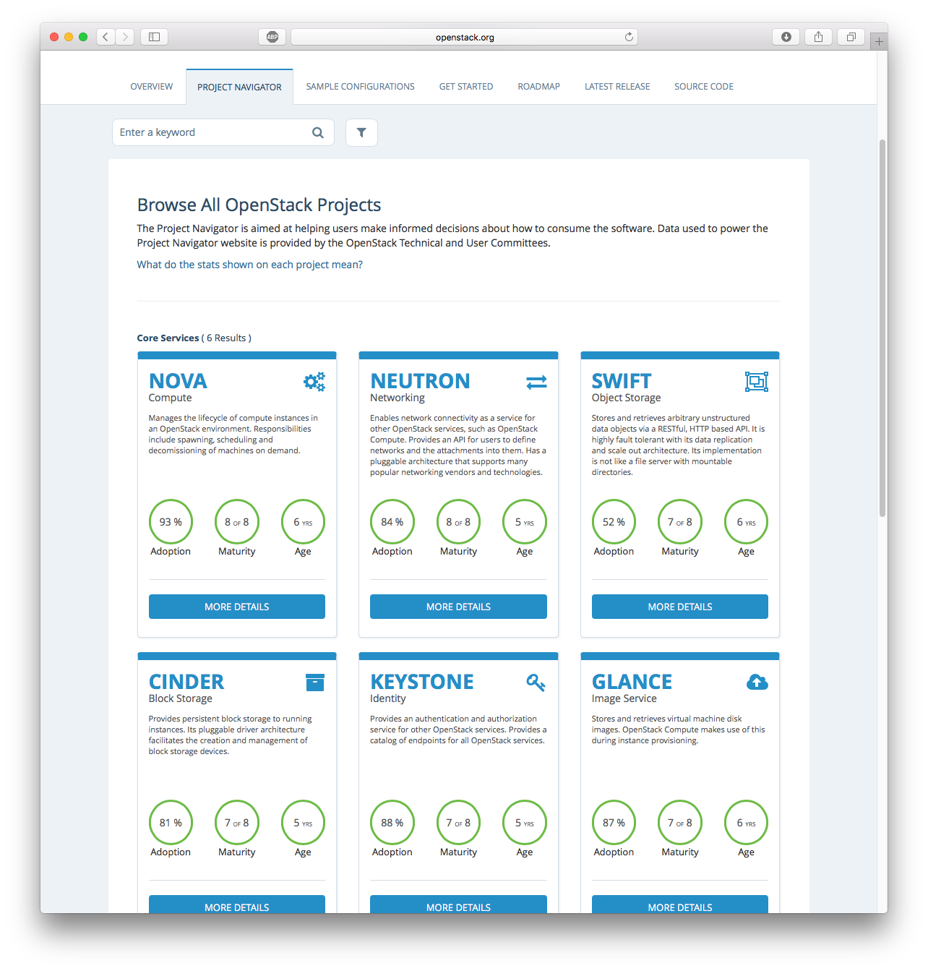
_{WHAT IT IS}
_{WHY USE IT}
_{THE COMMUNITY}
_{USING OPENSTACK}
_{FAQS}
The OpenStack Framework
WHAT GETS CALLED OPENSTACK?
USING THE SAMPLE CONFIGURATIONS
CORE SERVICES & OPTIONAL SERVICES
Notes:
Update screenshot: Project Navigator
A common misunderstanding is that OpenStack is a single product. OpenStack is a group of nearly 60 open source projects, and which projects you’ll need will depend on how you want to use OpenStack. While there is a large list of projects you can plug into your OpenStack cloud, not all of them are necessary for all use cases, and not all projects have reached maturity with the service they provide. These projects are still included under the OpenStack umbrella because they work towards the OpenStack mission, and some users want early access to the latest services. When you explore OpenStack projects, you will find a maturity rating that will help you understand if this project is right for you.
On the Foundation website, you will find a list of sample configurations. These are sample combinations of services for different use cases, informed by case studies and real world users. In the sample configurations, you will notice services referred to as “core” and “optional.” The core services typically build the foundation for a use case, supported by the optional services that create the cloud you need. There are six core services: block storage (Cinder), image service (Glance), compute (Nova), identity (Keystone), networking (Neutron) and object storage (Swift). Not all use case requires all six services; you only need the core services relevant to your use case.
An amazing thing about open source and the OpenStack community is that new projects are being developed all the time to provide services that users demand. There’s no wishing that an offering had a feature, but being stuck and unable to change it. Anyone can get involved in the community and create what they see a need for.

Slide 15
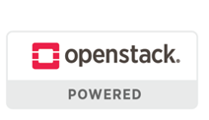




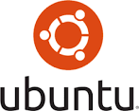


_{WHAT IT IS}
_{WHY USE IT}
_{THE COMMUNITY}
_{USING OPENSTACK}
_{FAQS}
How do you get OpenStack?
1
2
3
Distros—manage packaging and testing
Managed private cloud
Public cloud provider
Remotely managed in your datacenter
A
OR
B
Hosted private cloud in service provider facility
openstack.org/marketplace
Notes:
There are multiple ways to get OpenStack, depending on how you plan to deploy and manage your cloud. You can deploy and manage your cloud yourself, or get help from a consultant with either deployment or management. You can get it as part of an existing Linux distribution that you may have, like Ubuntu, Red Hat or SUSE. You can get OpenStack packaged from a vendor, like Mirantis. You can also elect to put your needs with a provider who runs OpenStack, like IBM, Rackspace or Cisco. Make sure to look for OpenStack Powered, to find tested OpenStack services.
Each of these different options is detailed in a booklet from the Foundation called “Path to Cloud.” That resource can help you discover what option best fits your needs and use case. You will find it at openstack.org/enterprise.
~~~
Another great resource is the Project Navigator. The Project Navigator is a list of OpenStack projects and services, as well as sample configurations. It gives updates on the projects and shows maturity of the various services. Visit openstack.org/software for more info.

Slide 16
_{WHAT IT IS}
_{WHY USE IT}
_{THE COMMUNITY}
_{USING OPENSTACK}
_{FAQS}
OpenStack’s software releases
_{NEWTON}
_{OCATA}
_{PIKE}
_{QUEENS}
October 2015
February 2017
August 2017
February 2018
Releases happen every 6 months
In development
Most clouds run one of the two most recent releases
Learn more about the releases at openstack.org/software
Notes:
A new version of OpenStack is released every six months. The release names go in alphabetical order; OpenStack released Ocata in February 2017, and is currently working on the next release, Pike.

Slide 17
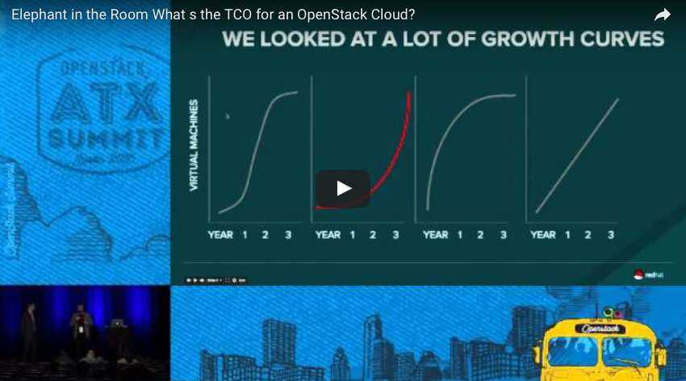
_{WHAT IT IS}
_{WHY USE IT}
_{THE COMMUNITY}
_{USING OPENSTACK}
_{FAQS}
It costs less and does more
“TD Bank...experienced a 25% to 40% costs savings on their platforms and virtual machines over their previous solution by deploying OpenStack.”
“In all private cloud-based applications…we expect approximately 70% of cost savings as compared to classical IT solutions.”
–Holger Urban, Volkswagen
–Forbes, “3 Reasons Why An OpenStack Private Cloud May Cost You Less Than Amazon Web Services”
Watch this session:
Elephant in the Room: What's the TCO for an OpenStack Cloud?
Notes:
People commonly ask about cost comparisons. OpenStack costs less and does more. At the Austin OpenStack Summit, a panel explored the various things to take into account when evaluating OpenStack TCO, and a video recording of that session is available.

Slide 18
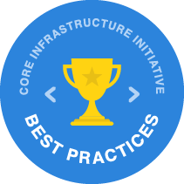


_{WHAT IT IS}
_{WHY USE IT}
_{THE COMMUNITY}
_{USING OPENSTACK}
_{FAQS}
OpenStack is recognized for its security
“The OpenStack community is taking security seriously…”
openstack.org/software/security
Notes:
Another common question is about security. The OpenStack community takes security very seriously. OpenStack was the only open source project to win the Linux Foundation’s Core Infrastructure Initiative Best Practices award, which recognizes security best practices, with no suggestions for improvement.
The OpenStack Security Team has been praised for their swiftness in identifying and resolving security threats in OpenStack code. To assume that OpenStack’s open source nature makes it insecure is a misunderstanding of the open source process. On the contrary, you have multiple teams--using the software for a variety of cases--all working towards a common security goal. That creates a vast set of eyes and a passionate community who are invested in a secure, high quality platform. The OpenStack Security Team has a best practices handbook that can be found on their documentation page, which is good reading for those determining OpenStack security protocols.

Slide 19
_{WHAT IT IS}
_{WHY USE IT}
_{THE COMMUNITY}
_{USING OPENSTACK}
_{FAQS}
You don’t need to hire new employees
Train who you have...
Get them certified...
But if you want to...
Training openstack.org/marketplace/training/
Certified OpenStack Administrator openstack.org/coa
Post a job (for free!)
openstack.org/jobs
Notes:
And lastly, many ask, “Do I need to hire a new team?”
You don’t need new employees. For existing employees, OpenStack trainings can help fill the gaps in their knowledge. Dozens of partners offer trainings; you can find them in the OpenStack Marketplace. You will also see that some training partners are recognized as “COA Partners.” The COA is the Certified OpenStack Administrator exam. A COA professional is someone who has demonstrated skills in the fundamentals of using OpenStack.
But if you do decide you want to bring on new staff, post a job for free at openstack.org/jobs. In your posting, you can even select “COA required” if you know you want an OpenStack admin certified individual.

Slide 20
_{WHAT IT IS}
_{WHY USE IT}
_{THE COMMUNITY}
_{USING OPENSTACK}
_{FAQS}
Next Steps
How you can get started in OpenStack…
1
JOIN THE FOUNDATION
2
JOIN THE MAILING LISTS
3
READ THIS COLLATERAL: BUSINESS PERSPECTIVE, PATH TO CLOUD
4
ATTEND AN EVENT IN YOUR AREA: OPENSTACK.ORG/EVENTS
5
MORE RESOURCES: OPENSTACK.ORG/SOFTWARE/START/

